Slide 1
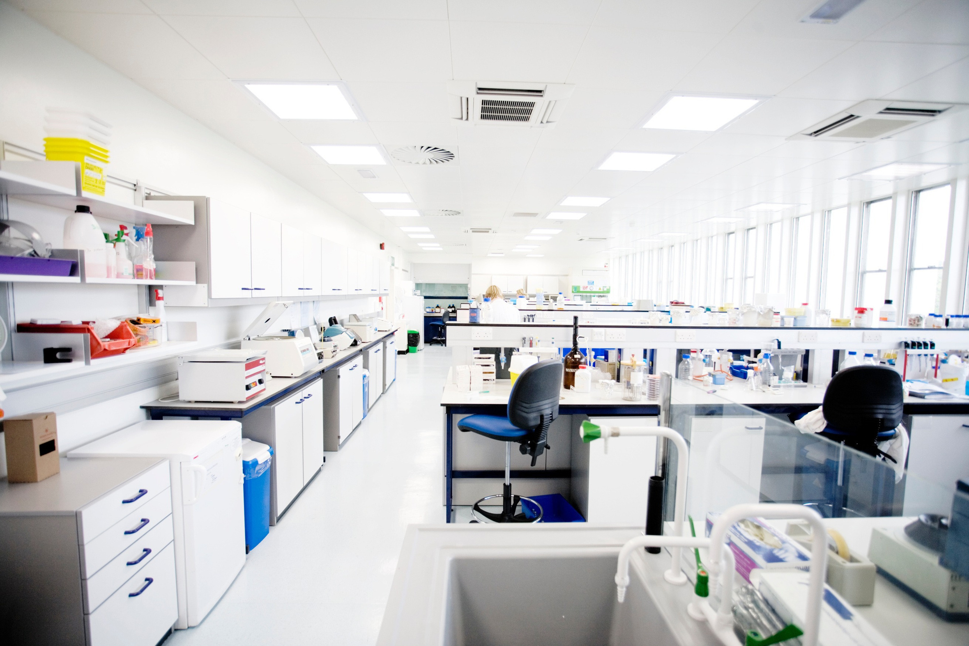



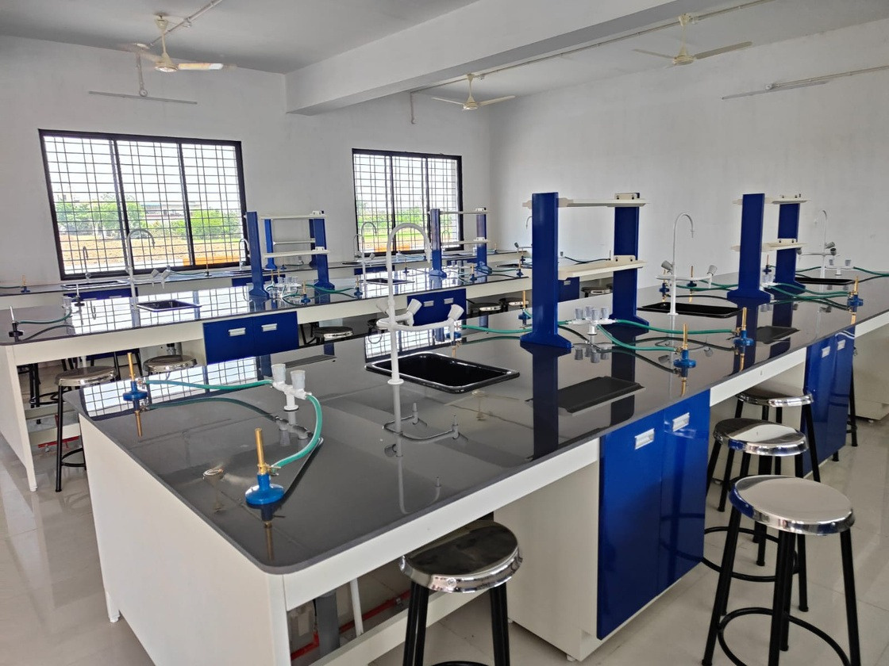

MR. SHYAM ZADE
10+ YEARS OF INDUSTRY EXPERTISE MAHARASHTRA & PAN INDIA ISO CERTIFIED
SPECIALIZING IN:
INSTITUTIONAL SCIENCE LAB
INDUSTRIAL SETUP
TURN KEY BASIS LAB

Slide 2


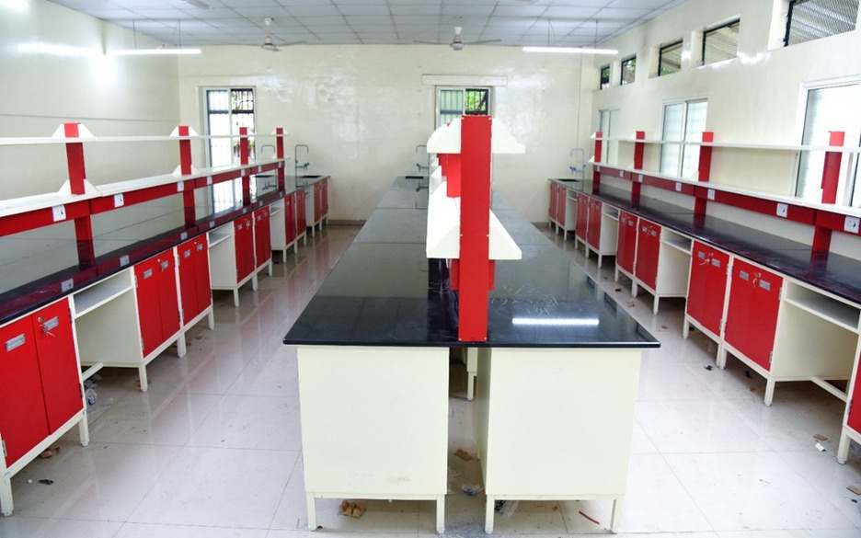

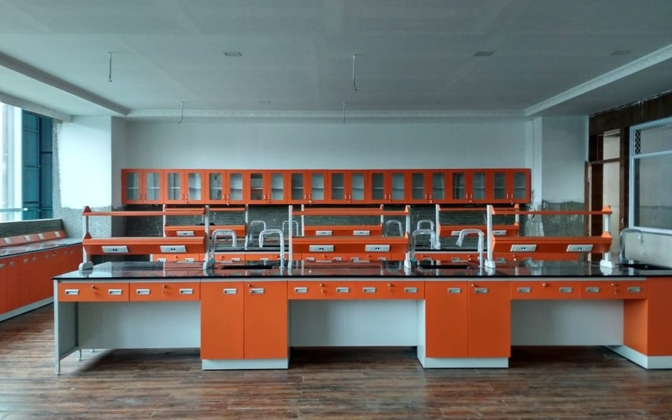

INTRODUCTION
“Biocon Scienttific” is an autonomous Proprietorship company in Pune. Our Director Mr. Shyam Zade who has 15 years of cross functional corporate experience in various Engineering MNCs and few small scale Industries. With his leadership and vast experience in R&D labs and Educational Institutes as professor also give an extra edge for understanding Customer requirements.
Starting with Laboratory Consumables we are now adept at supplying complete Science Laboratory including Lab Furniture, Consumables and Equipment’s. So we can provide single window for all our customers.

Slide 3






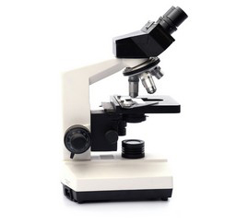






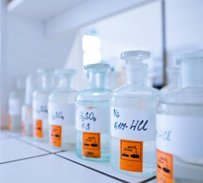
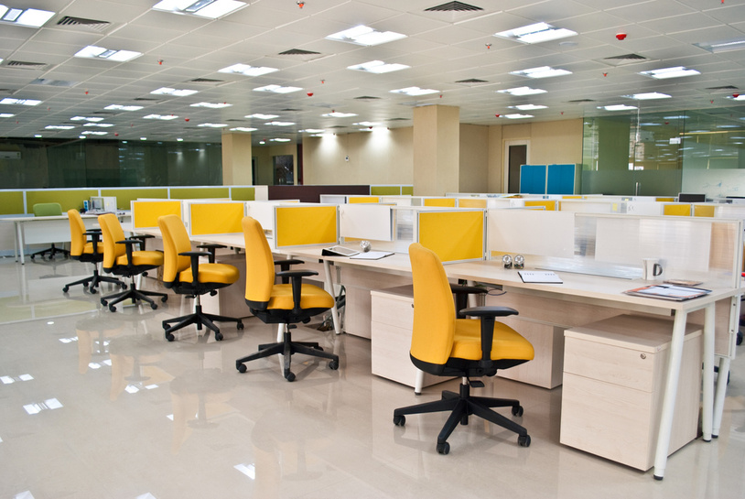


OUR VERTICALS
Solutions for Every Lab
Science Laboratory
Laboratory Consumable
Educational Institutes & Industries
Modular Office Furniture

Slide 4



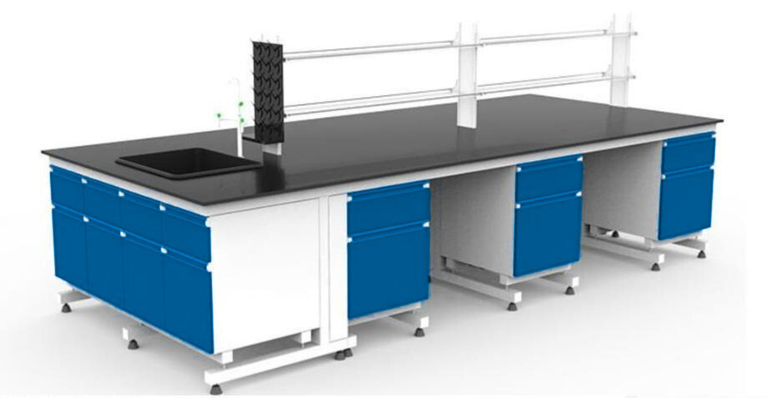
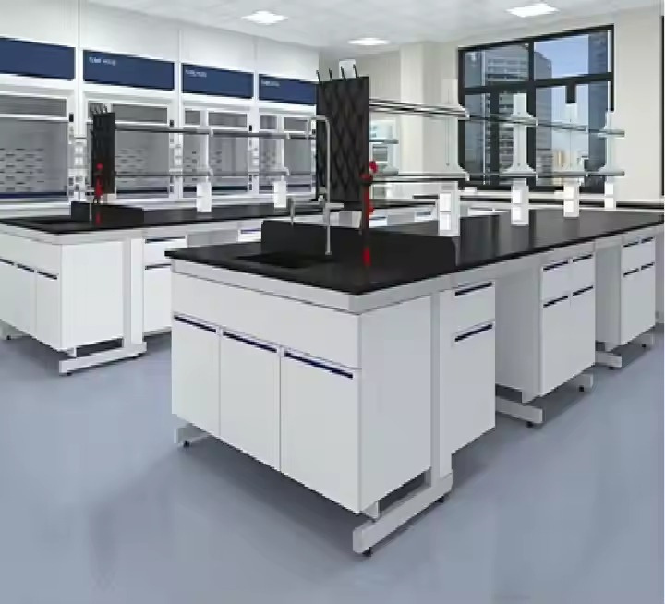



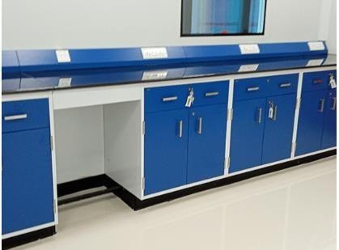
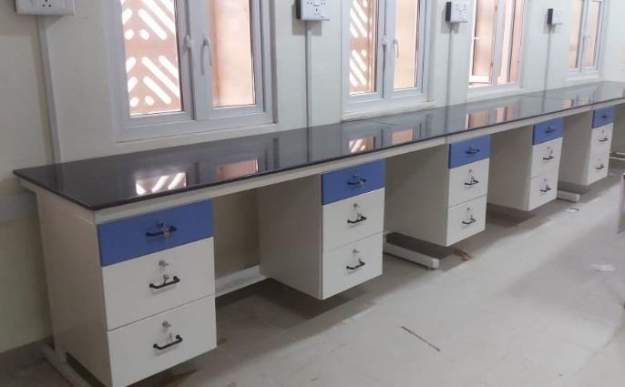

SCIENCE LAB
Island Table
C- Frame
Side Table
Side Wall Table

Slide 5



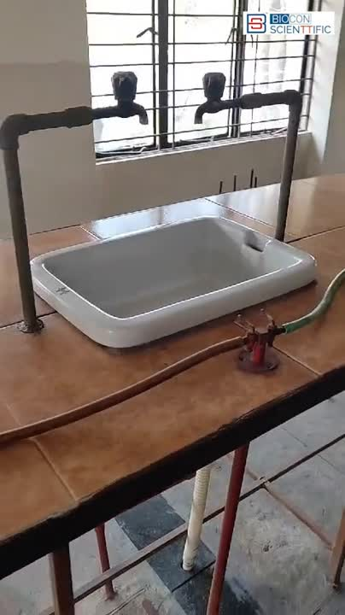
NEW LAB & RENOVATION

Slide 6


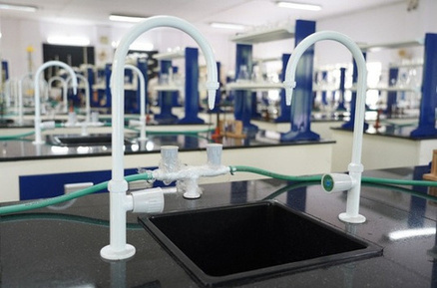
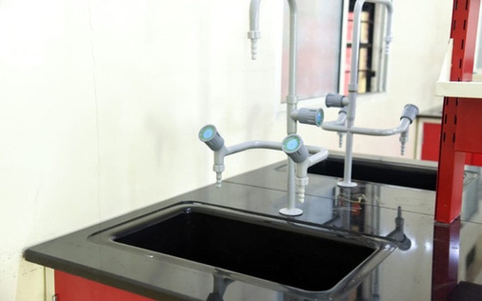

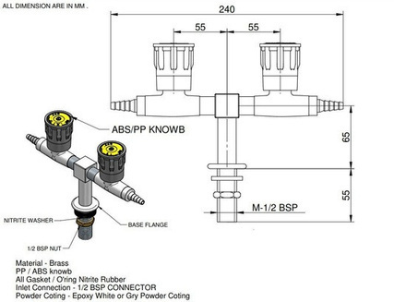

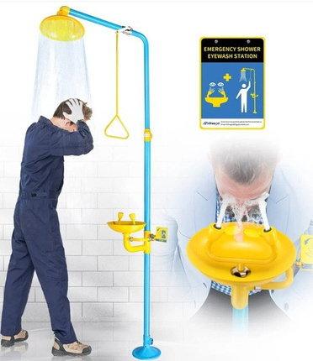

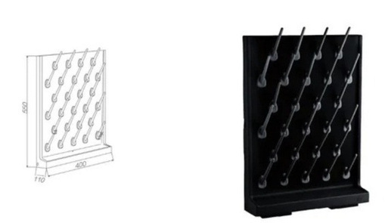
LABORATORY ACCESSORIES WE PROVIDE:
WHAT ELSE WE DO?
      Pp Sink
      Water Tap
      Gas Valves
      Pp Peg Board
      Safety Items: Eye Wash Shower
      Robotic Lab
      Math Lab
      Environmental Lab

Slide 7

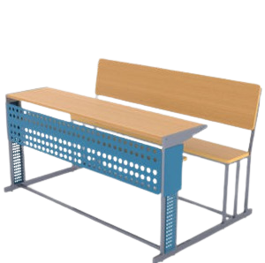


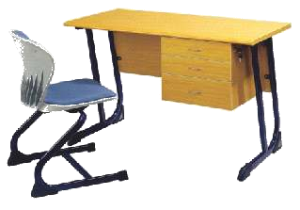

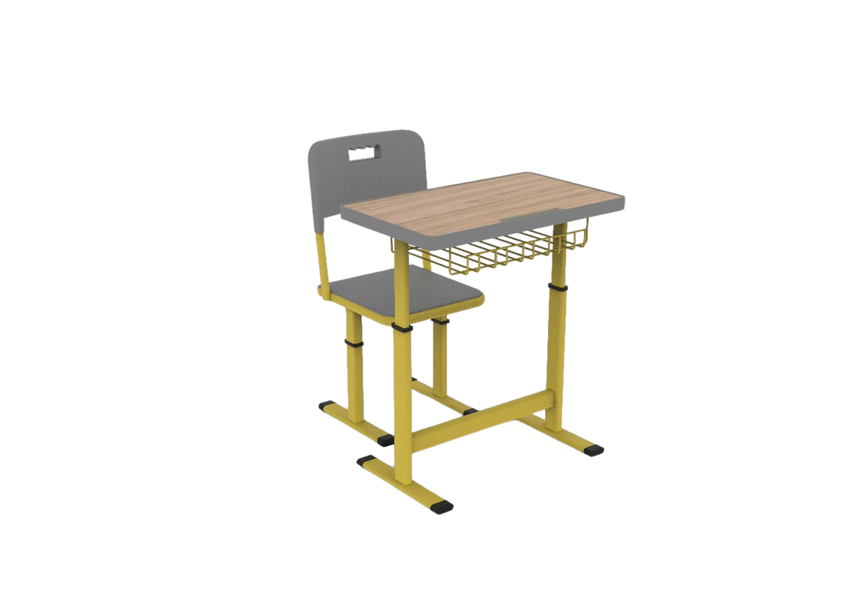

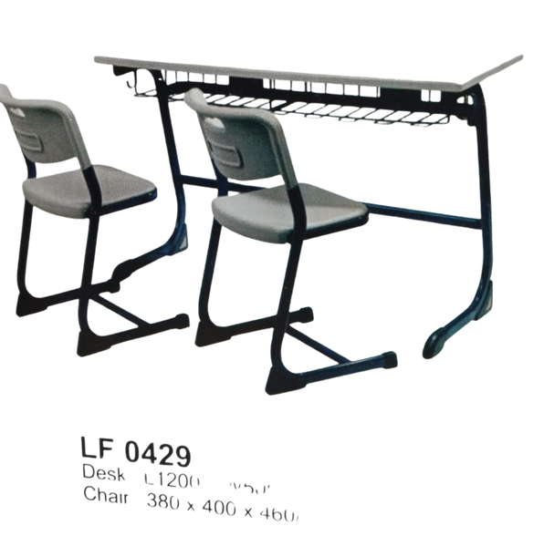
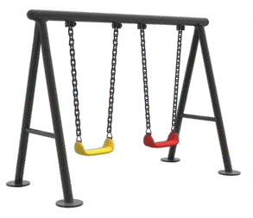

INSTITUTIONAL FURNITURE
Classroom
Childwood

Slide 8
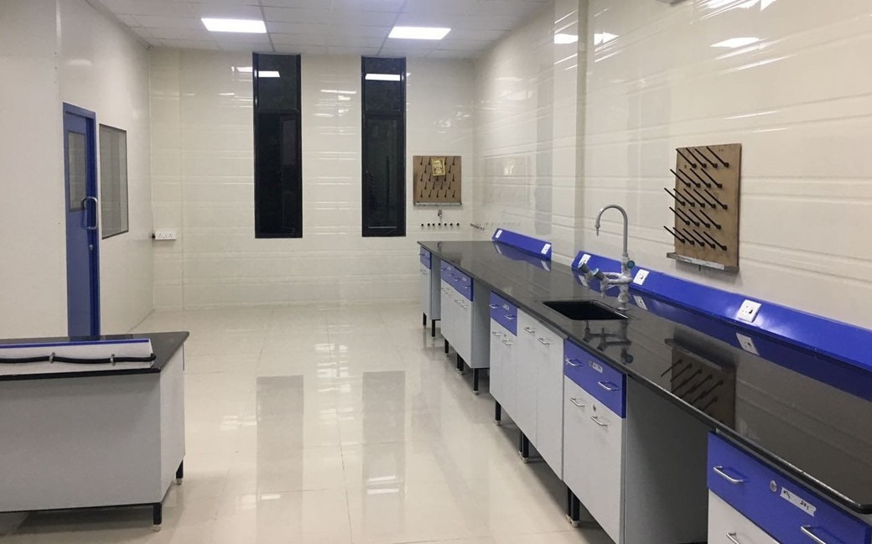



ASKs
GIVEs
CSR Funded Project Panchgani School Vibgyor School Walnut School New Pharmacy & Nursing College
Mahindra School SNBP School DY Patil School Paint Companies Institute at Nagpur Soft Skill Training - Education Consultants

Slide 9




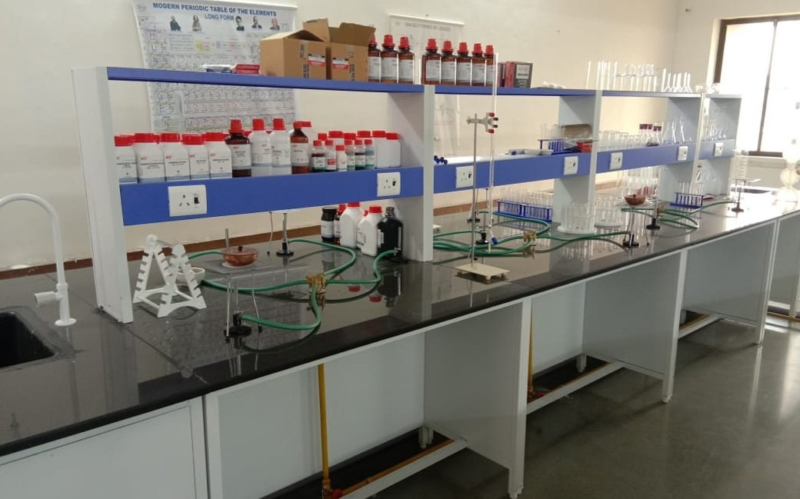



THANK
YOU !
www.bioconscienttific.com
+91 841 104 1652
sales@bioconscienttific.com

